Slide 1
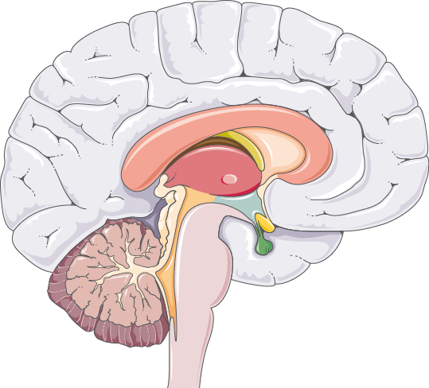
Young Engineers Tallahassee Presents: The Biomechatronic Brain
Made by the 6th-8th Grade YET Class

Slide 2
Table of Contents
01
02
03
04
05
Introduction
Sensors
Programming
Build Photos
Videos
Notes:
Empress

Slide 3
01
Introduction
Explaining the background for this project and the functions of the brain.
Notes:
Empress

Slide 4
Our Students!
Students excluded due to parental preferences.
Notes:
Empress

Slide 5
What are the brain’s functions?
The brain is responsible for processing sensory information. The brain can process data from the five senses sight, taste, touch, sound, and smell. Different lobes are responsible for different senses. Occipital lobe is for sight and the temporal is responsible for hearing.
The brain is also responsible for controlling the body and all of the other organs. It also regulates bodily functions like heart rate, breathing, and digestion. The brain also controls voluntary movements such as walking and moving your arms.
Notes:
Empress

Slide 6
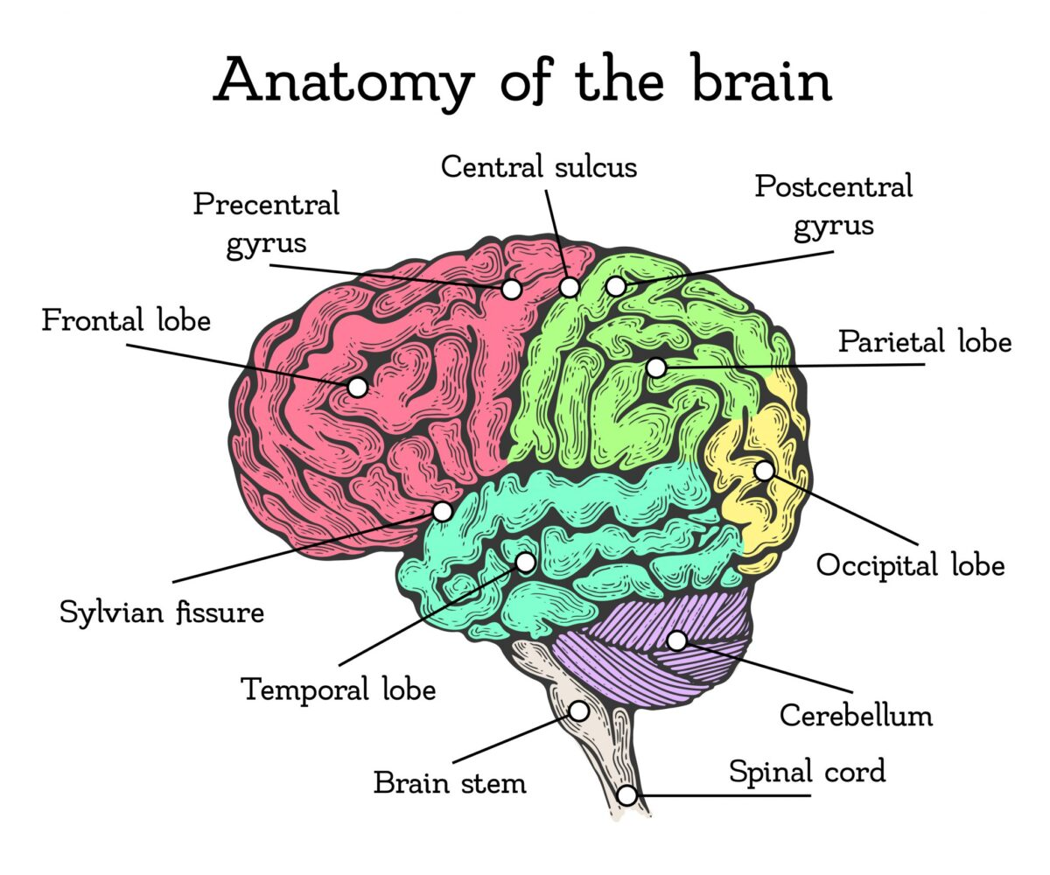
A picture always reinforces the concept.

Slide 7
The Sensors!
02
The sensors we used for our brain! :)
Notes:
Evan

Slide 8
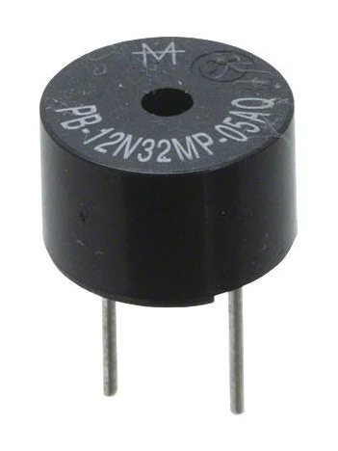
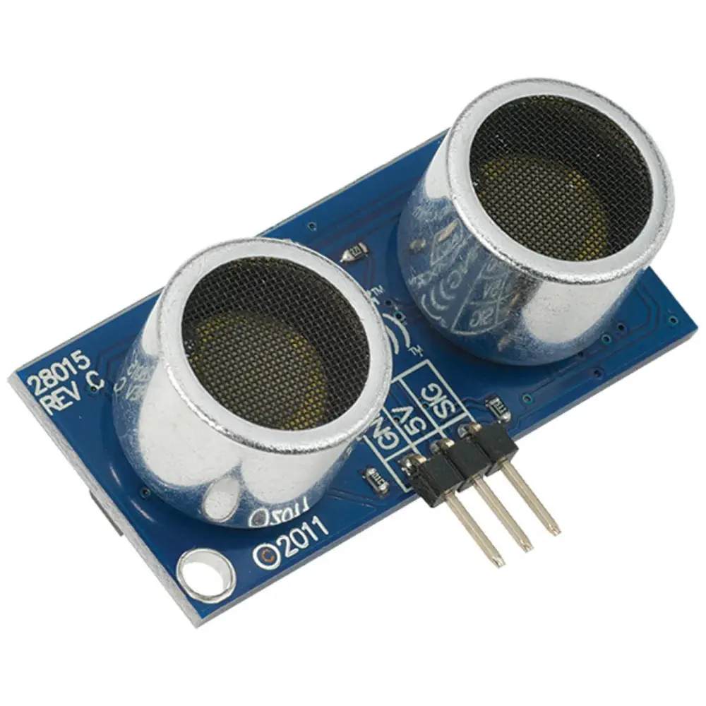
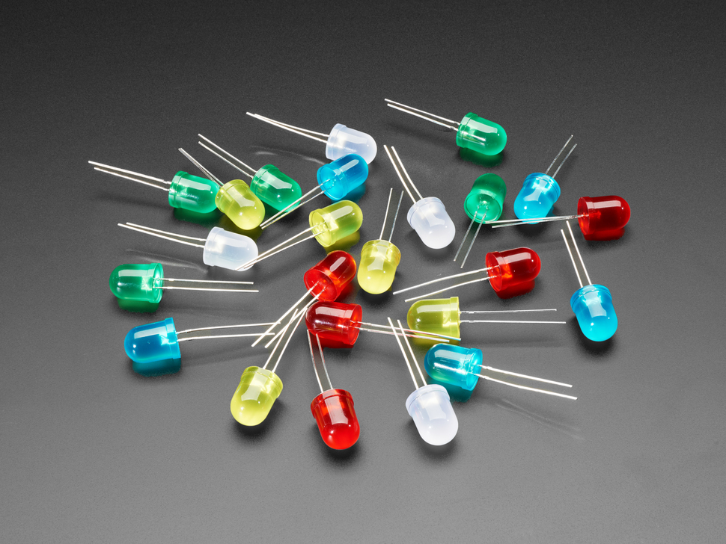
Buzzer
Distance Sensor
LEDs
Notes:
Evan

Slide 9
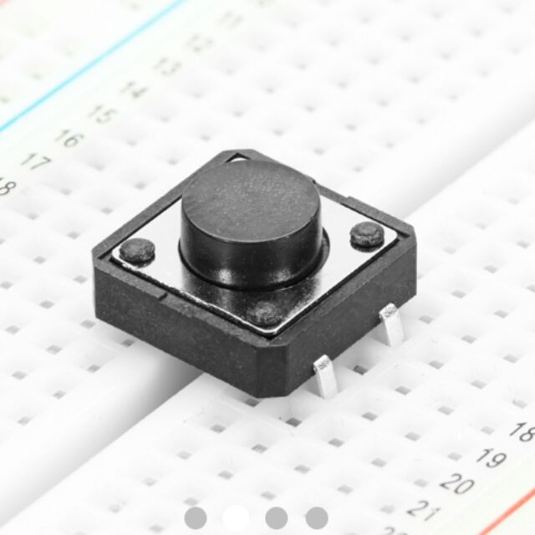
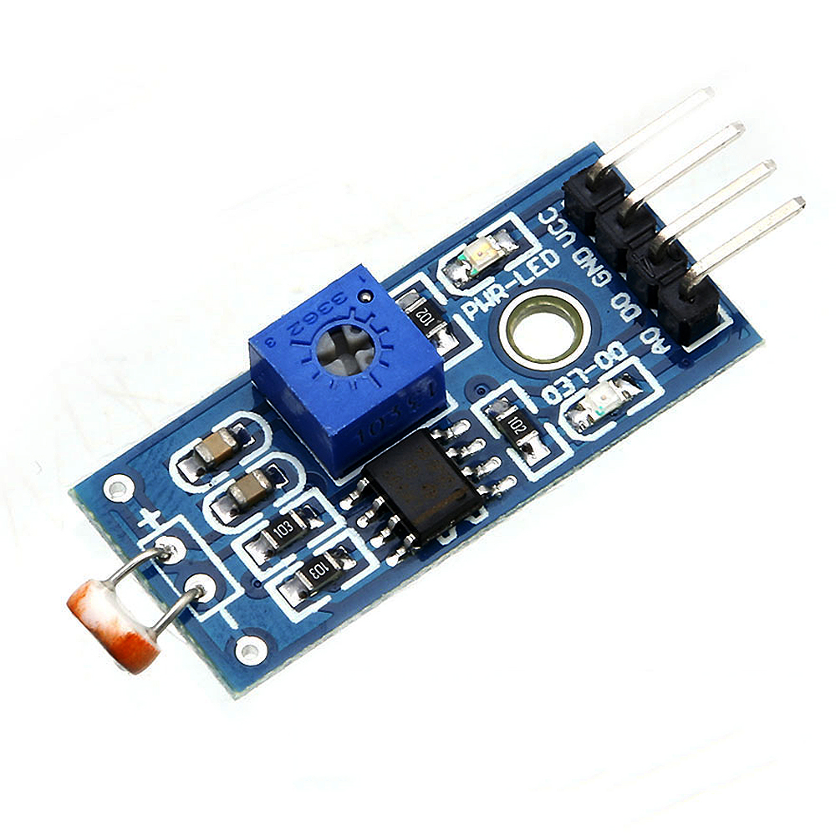
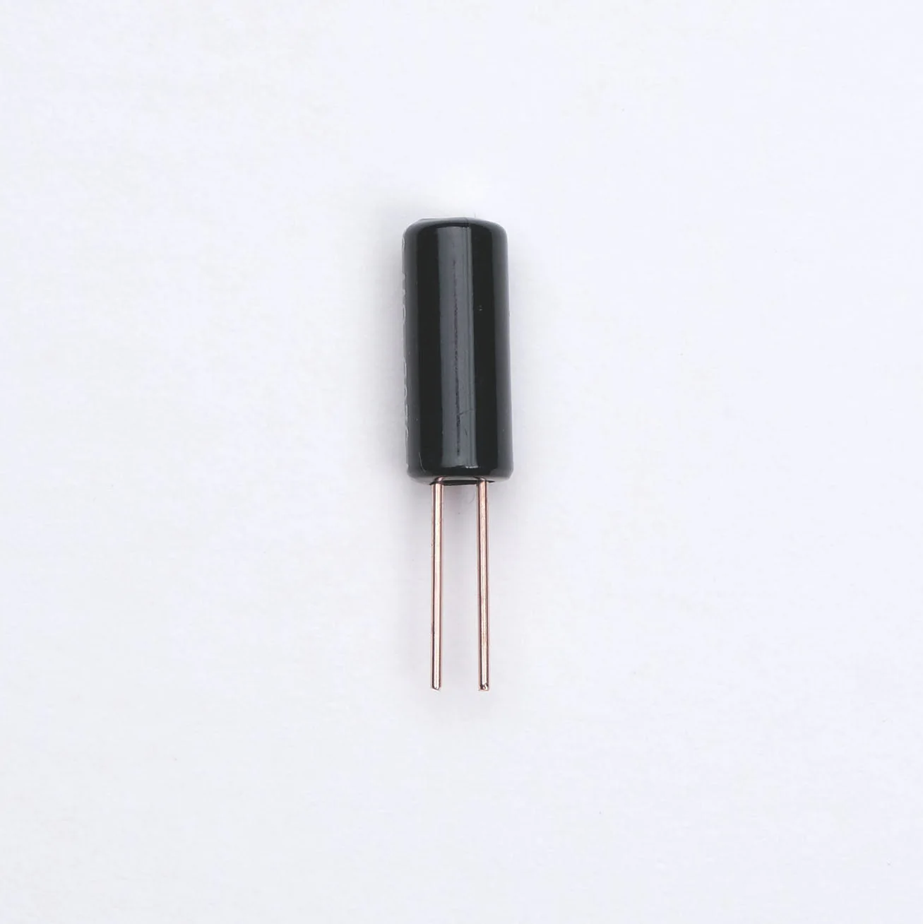
Button
Photoresistor
Tilt Sensor
Notes:
Evan

Slide 10
03
Programming
The Arduino code we used to program the brain.
Notes:
Ben

Slide 11
Full Code

Slide 12
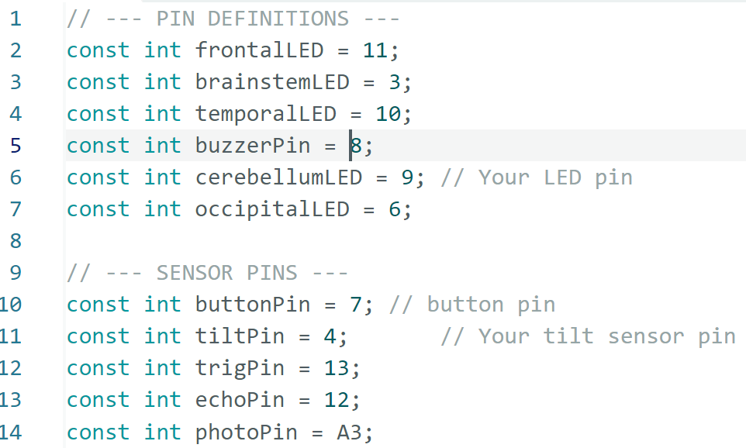

Slide 13
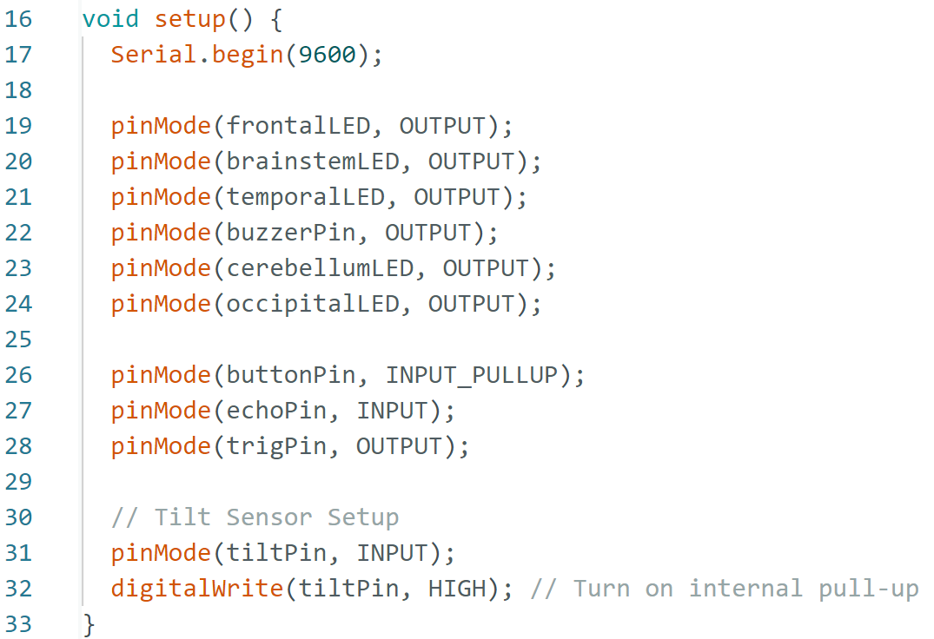

Slide 14
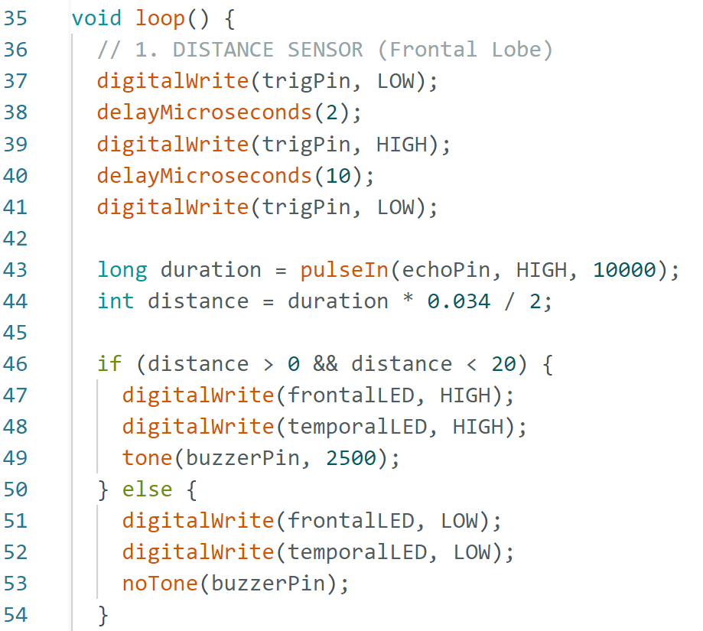

Slide 15
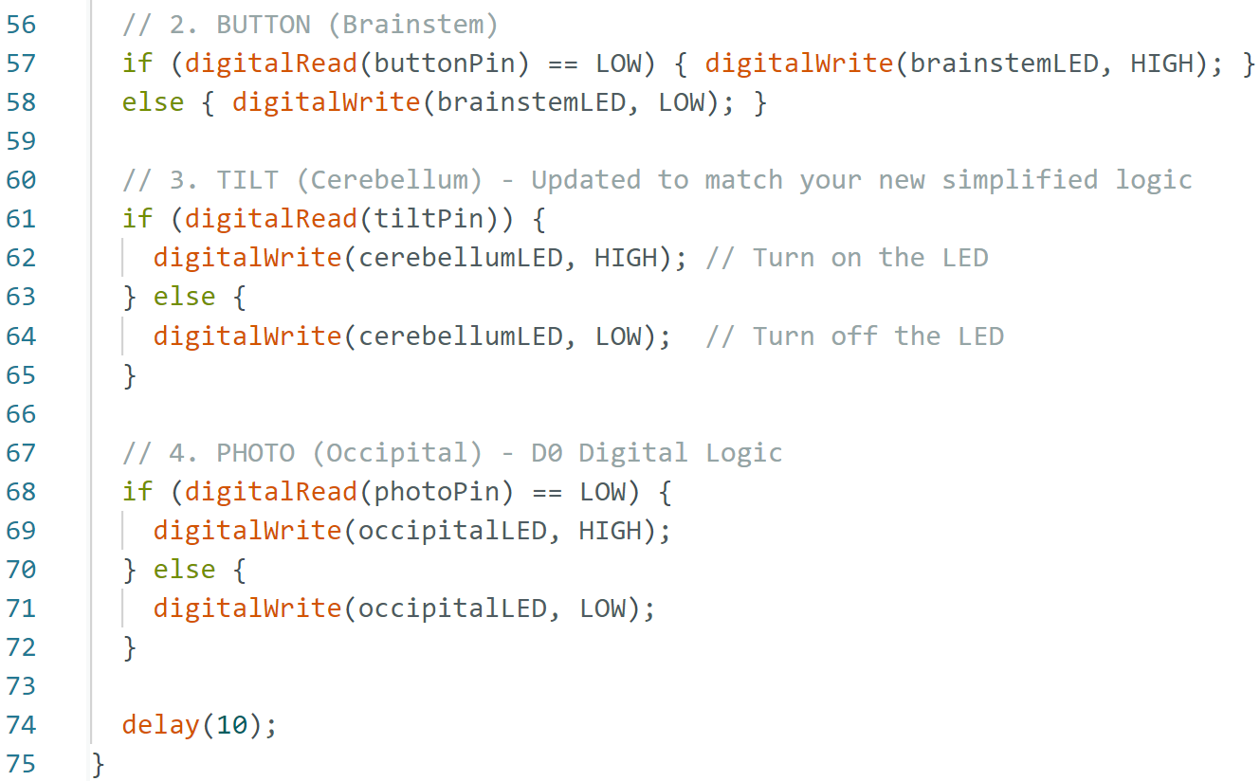

Slide 16
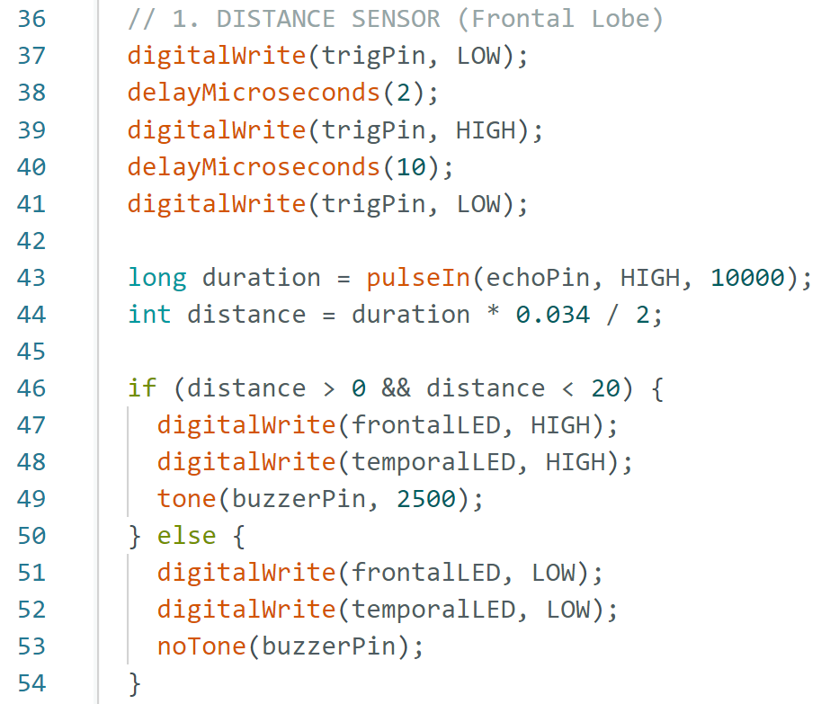
Frontal Lobe (Distance Sensor)
Notes:
Spencer

Slide 17
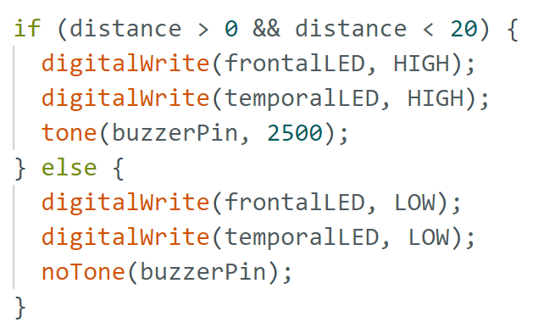
Temporal Lobe (Buzzer)
Notes:
Spencer

Slide 18
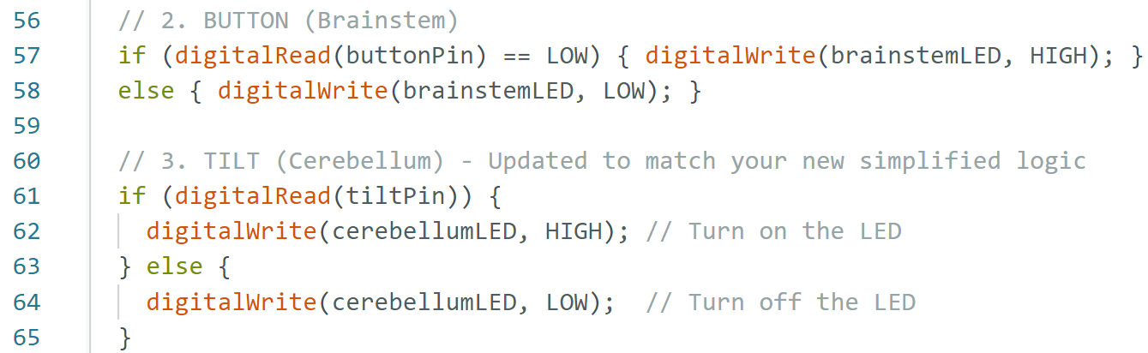
Brainstem (Button)
Notes:
Spencer

Slide 19
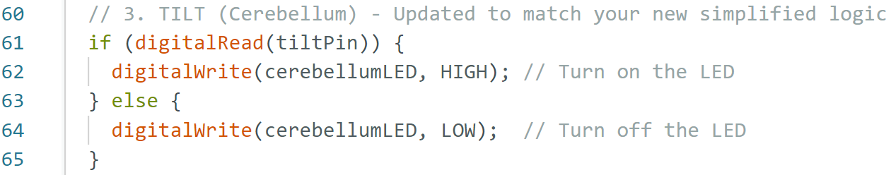
Cerebellum (Tilt Sensor)
Notes:
Spencer

Slide 20
Build Photos
04
Notes:
Austin

Slide 21
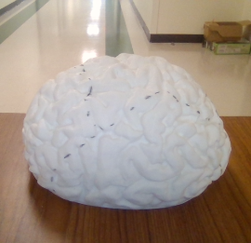
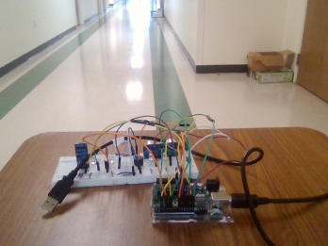
Notes:
Austin

Slide 22
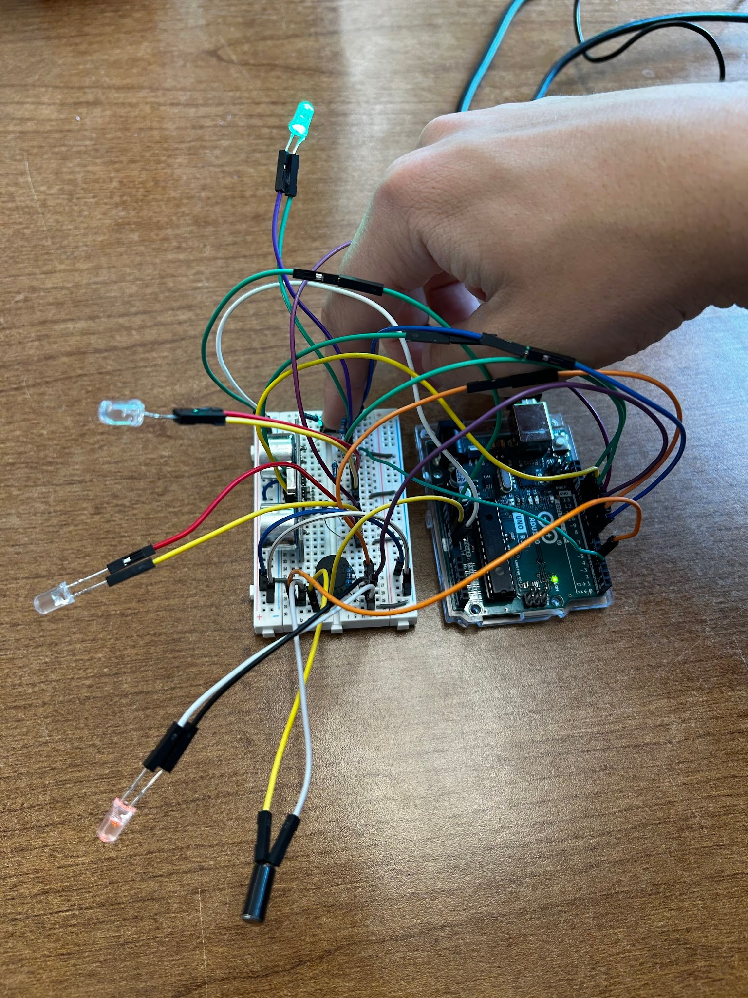
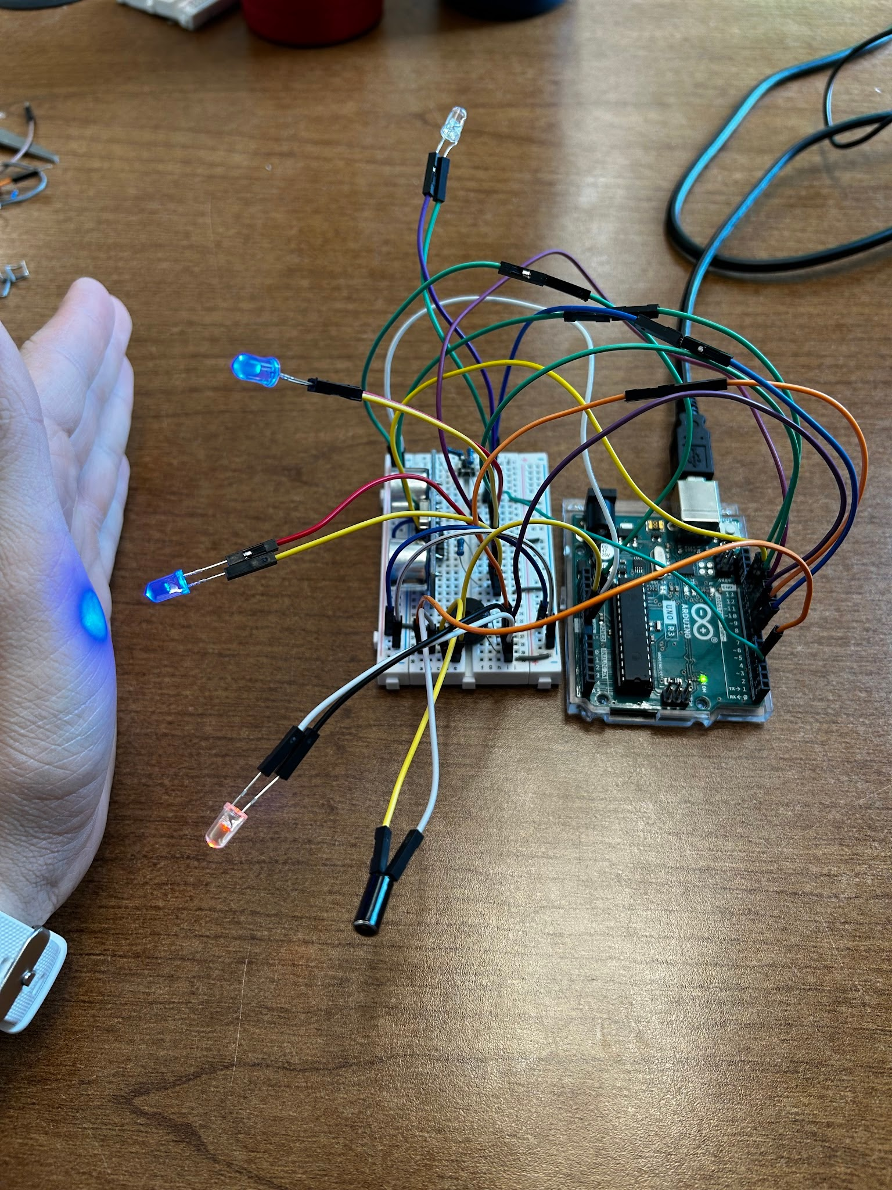
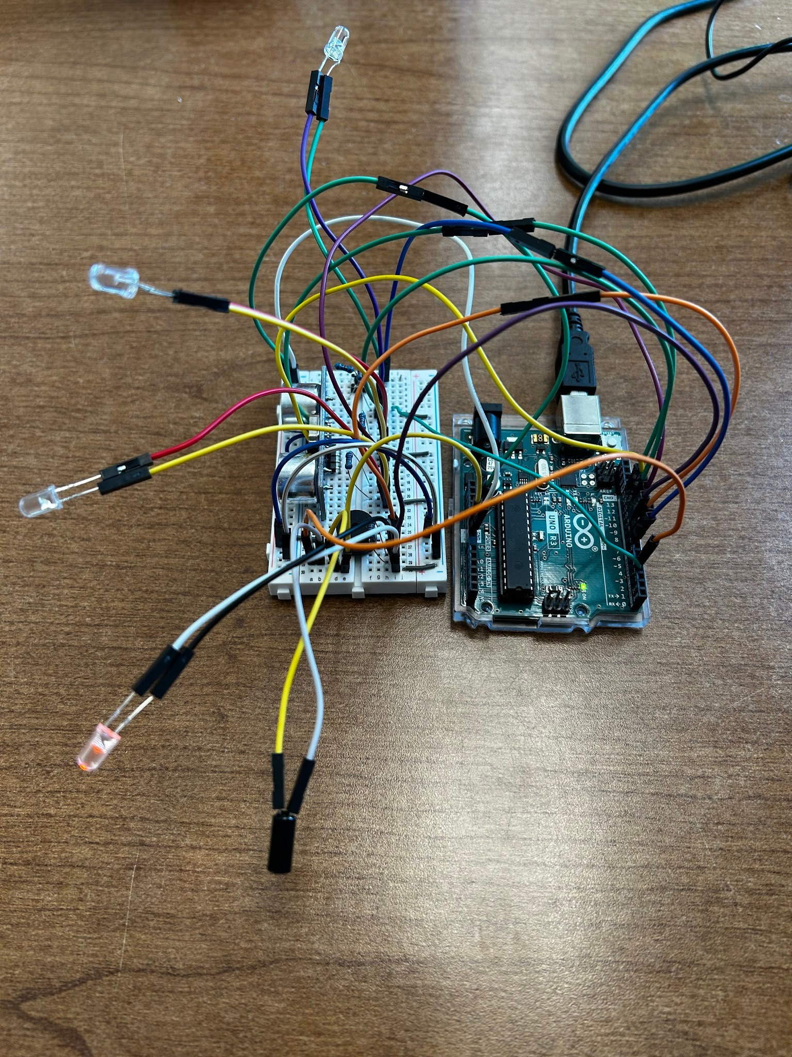

Slide 23
05
Video
Notes:
Austin

Slide 24


Slide 25
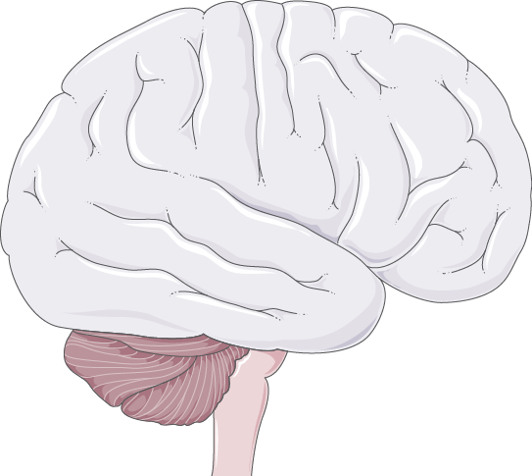
Thanks!

